Slide 1

Docker Sharing Session
Part 2
29 January 2020

Slide 2
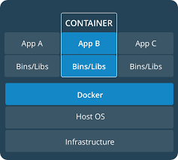
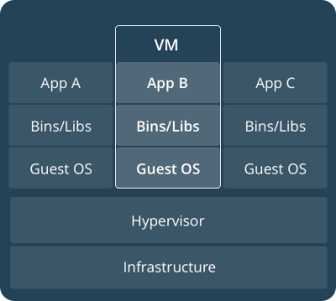
Recall

Slide 3
Why
Isolation
Portability
Dynamic Allocation
Microservices
Single responsibility
Multiple point of failure

Slide 4
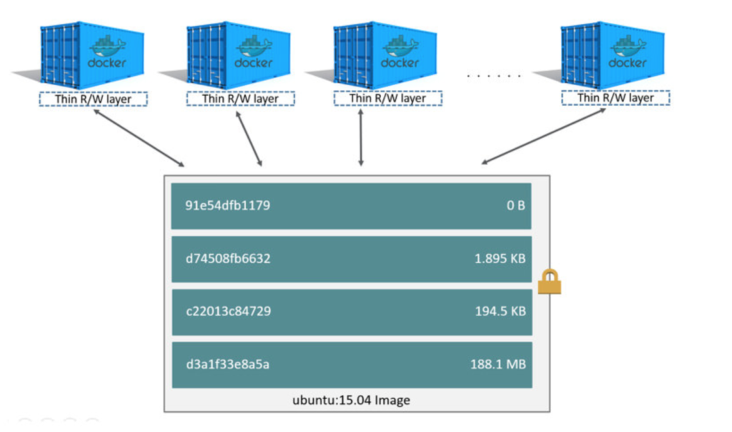
Container Layer

Slide 5
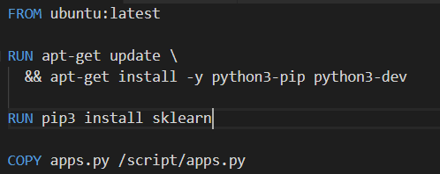
Dockerfile
COPY
RUN
RUN
FROM ubuntu:latest

Slide 6
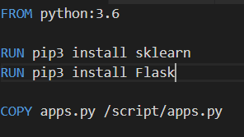
How to make the Dockerfile
FROM python:3.6 RUN pip3 install xgboost RUN pip3 install Flask RUN pip3 install sklearn RUN pip3 install pmdarima COPY coba.py /script/coba.py CMD ["python3", "/script/coba.py"]
EXISTING
WANNA CREATE

Slide 7
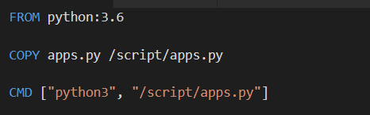
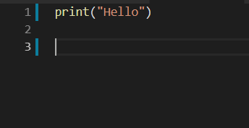
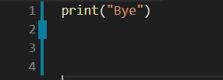
I have this, then what?
Existing docker images
Dockerfile
apps.py
Want to run this

